Slide 1
Observer Design Pattern

Slide 2
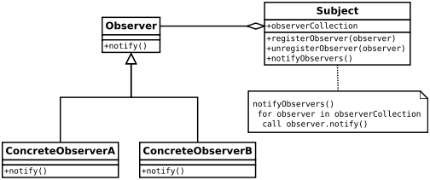
Introduction
Facade design pattern is categorized under behavioral design patterns.
The Observer Pattern defines a one to many dependency between objects so that one object changes state, all of its dependents are notified and updated automatically.
One to many dependency is between Subject(One) and Observer(Many).

Slide 3
Problem Definition
when multiple objects are dependent on the state of one object as it provides a neat and well tested design for the same.

Slide 4
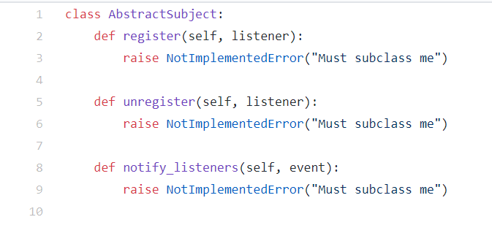
Example

Slide 5
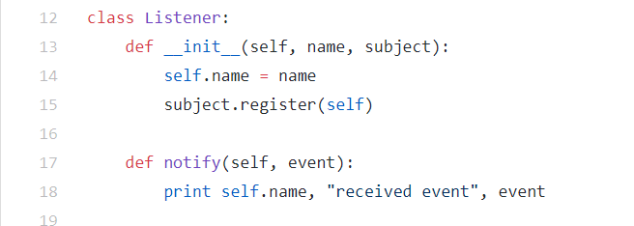

Slide 6
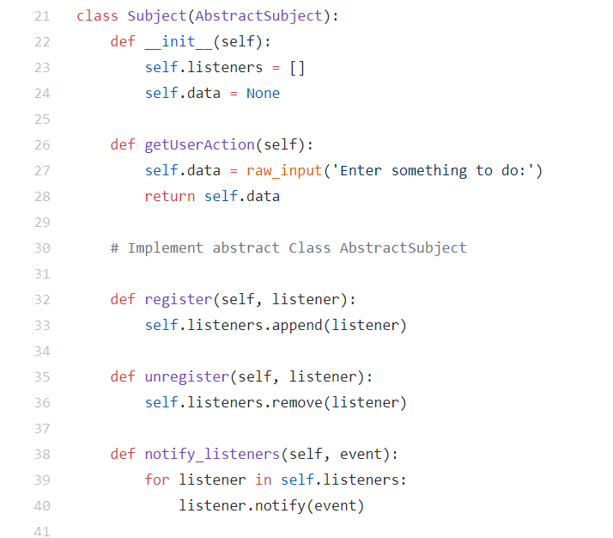

Slide 7
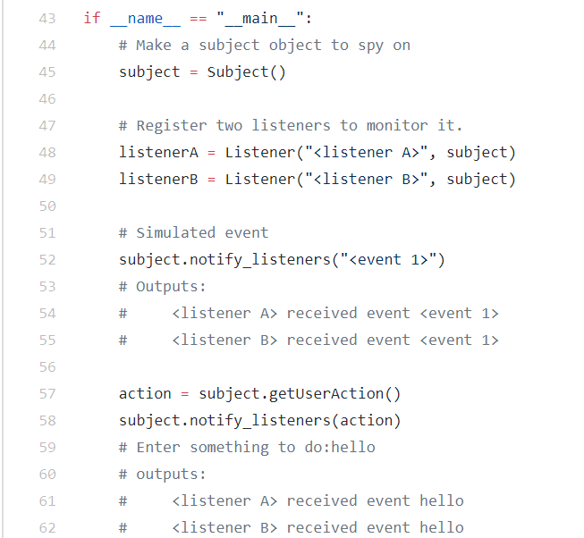

Slide 8
Advantages:
Provides a loosely coupled design between objects that interact.
We can reuse subject and observer classes independently of each other.

Slide 9
Disadvantages:
Memory leaks caused by Lapsed listener problem because of explicit register and unregistering of observers.

